Slide 1
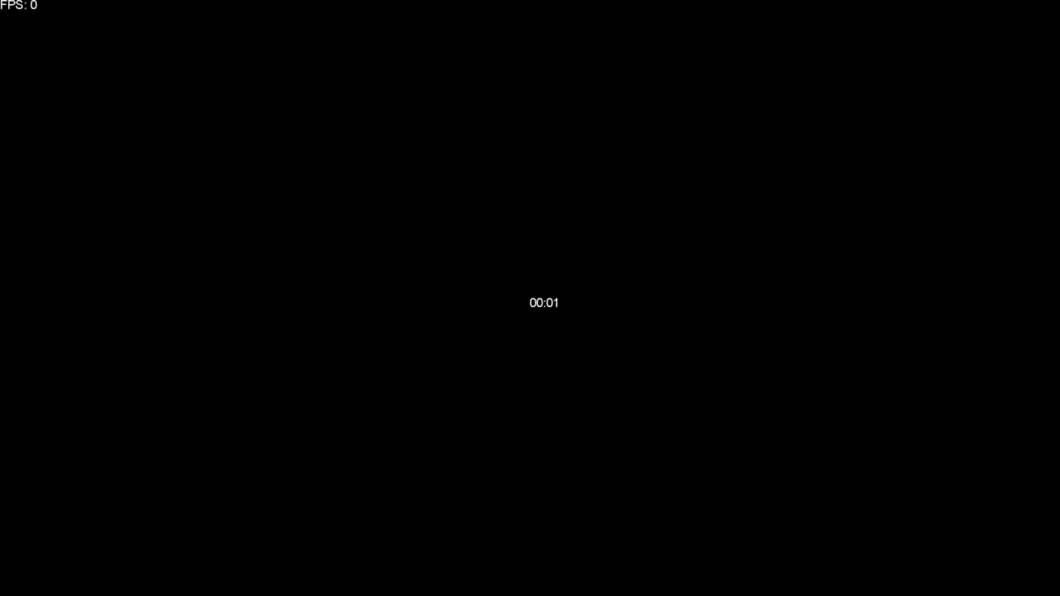
Astrea.
A.K.A Shooting Stars

Slide 2
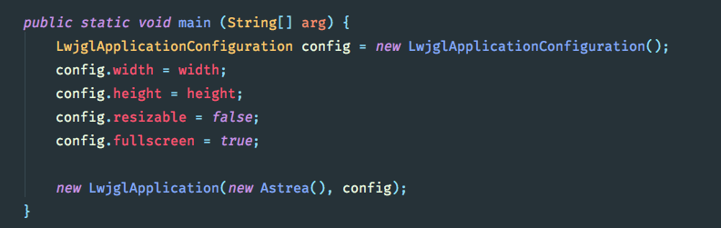
DesktopLauncher

Slide 3
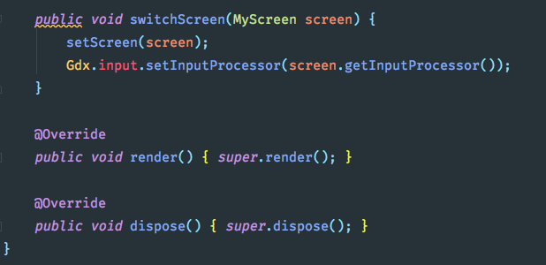
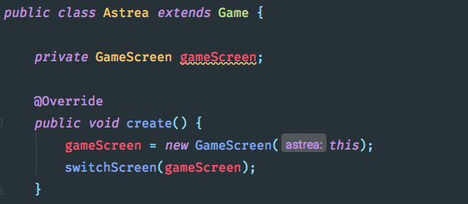
DesktopLauncher

Slide 4
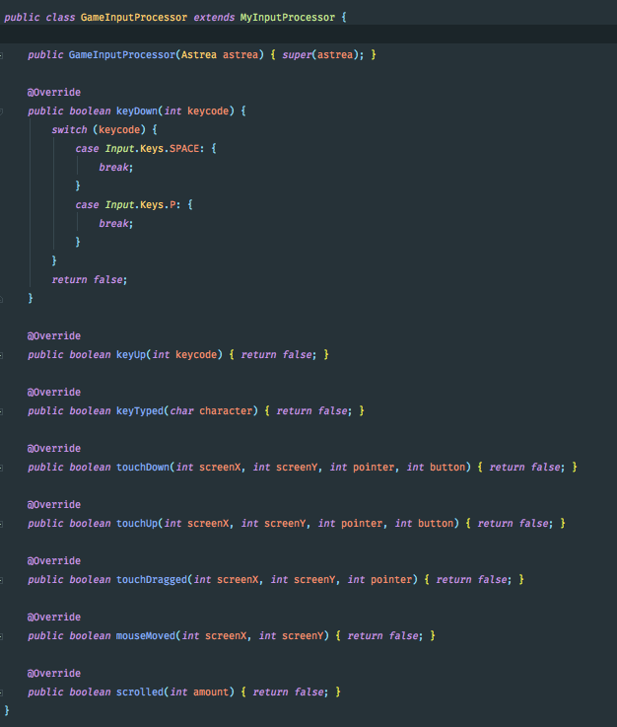
Astrea

Slide 5
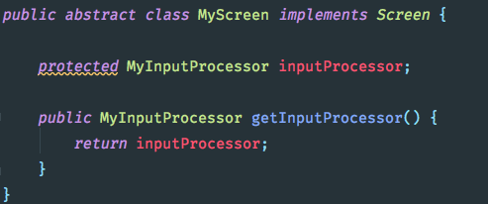
MyScreen
Literally just an abstract class that adds the input processor to every screen that we use. It implements LibGDX Screen Class.
MyInputProcessor
The input processor isn’t currently used, however if we decide to implement a menu screen it would pass input events to the screen.

Slide 6
MyInputProcessor
The input processor isn’t currently used, however if we decide to implement a menu screen it would pass input events to the screen.
MyScreen
Literally just an abstract class that adds the input processor to every screen that we use. It implements LibGDX Screen Class.

Slide 7
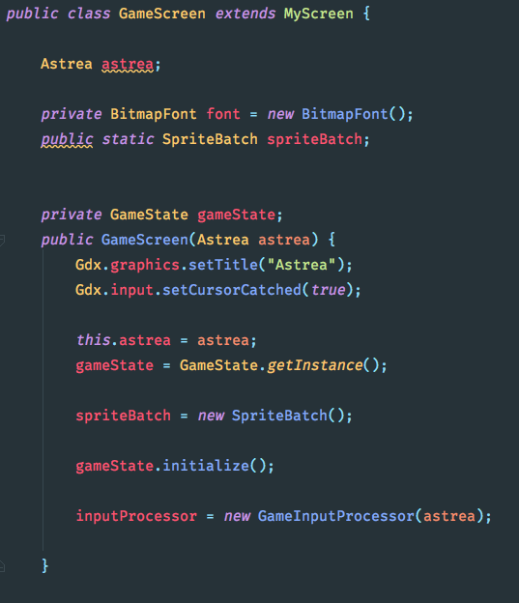
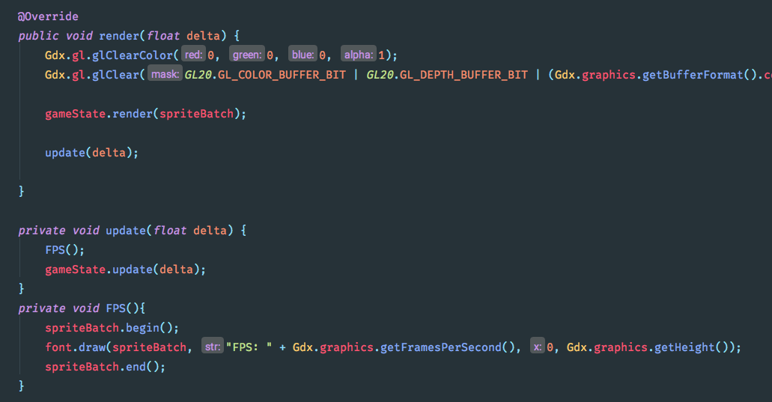
MyInputProcessor
The input processor isn’t currently used, however if we decide to implement a menu screen it would pass input events to the screen.
GameScreen
The game screen takes the update(), render() etc callbacks and passing them to the GameState.
It is also responsible for displaying the FPS.
The methods below just call the .render() and .update() methods on the GameState (see next slide) and renders the FPS before anything else.

Slide 8
MyInputProcessor
The input processor isn’t currently used, however if we decide to implement a menu screen it would pass input events to the screen.
GameScreen
The methods below just call the .render() and .update() methods on the GameState (see next slide) and renders the FPS before anything else.
The game screen takes the update(), render() etc callbacks and passing them to the GameState.
It is also responsible for displaying the FPS.

Slide 9
GameScreen
MyInputProcessor
The input processor isn’t currently used, however if we decide to implement a menu screen it would pass input events to the screen.
The methods below just call the .render() and .update() methods on the GameState (see next slide) and renders the FPS before anything else.
GameState
GameState keeps track of everything on the screen. It is responsible for rendering all the entities and calling the update methods. It keeps track of the round time and displays a countdown timer. The player calls shootBullet to create the bullets.
The game screen takes the update(), render() etc callbacks and passing them to the GameState.
It is also responsible for displaying the FPS.

